Slide 1

Topic 4
Data Analysis with Pandas
Official (Open) Non-Sensitive

Slide 2
Contents
Contents
Intro to Pandas
A first taste of Pandas
Pandas Data Structures
Series, DataFrames
Loading and Saving Data
Read/Write CSV, Write Excel, SQL
Retrieving Information
Basic Information, Summary
Selections
Subsetting rows, Subsetting columns
Reshaping Data
Dropping values, Merging, pivot, unpivot, sorting, reindexing
Handling Missing Data
Dropping Missing Data, Filling Missing Data
Group Data
Groupby
Applying Functions
apply, lambda
Official (Open) Non-Sensitive

Slide 3
Introduction to Pandas
Official (Open) Non-Sensitive

Slide 4
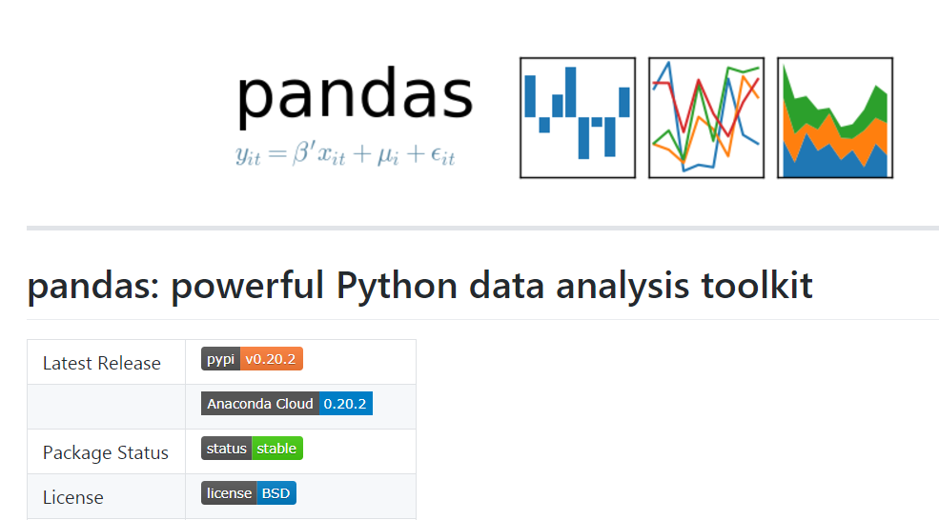
What is Pandas?
Introduction to Pandas
Pandas is a high-performance open source library for data analysis in Python
De-facto standard library for data analysis using Python
Widespread adoption of the tool with a large community behind it (817 contributors + 15,330 commits as in Jul 2017)
Rapid iteration, features, and enhancements continuously made
https://github.com/pandas-dev/pandas
Official (Open) Non-Sensitive

Slide 5
Key Features of Pandas
Introduction to Pandas
Can process a variety of data sets in different formats: tabular heterogeneous, time series, and matrix data.
Can load /import data from varied sources such as CSV, Excel and DB/SQL.
Allows manipulation of datasets such as subsetting, slicing, filtering, merging, groupBy, re-ordering, and re-shaping.
Allows handling of missing data according to rules defined by the user/developer: ignore, convert to 0, and so on.
It can be used for parsing and munging (conversion) of data as well as modeling and statistical analysis.
It integrates well with other Python libraries such as statsmodels, SciPy, and scikit-learn.
It delivers fast performance and can be speeded up even more by making use of Cython (C extensions to Python).
Official (Open) Non-Sensitive

Slide 6
What problem does pandas solve?
Introduction to Pandas
Python has long been great for data munging and preparation, but less so for data analysis and modelling
pandas helps fill this gap, enabling you to carry out your entire data analysis workflow in Python without having to switch to a more domain specific language like R
pandas does not implement significant modeling functionality outside of linear and panel regression; for this, look to statsmodels and scikit-learn.
Official (Open) Non-Sensitive

Slide 7
Getting Started with Pandas
Official (Open) Non-Sensitive

Slide 8
Objectives
Getting Started with Pandas
This section will show you a simple Pandas program that you can learn techniques to:
Load a simple CSV file
Show a preview of the first n rows and last n rows of the loaded dataset
Display information about the loaded dataset such as:
The count of how many rows and columns were loaded
The column names of each row and their datatypes
Extract subsets of the dataset
Save a subset of data
Official (Open) Non-Sensitive

Slide 9
Load a simple delimited file
Getting Started with Pandas
import pandas as pd
df = pd.read_csv('data/gapminder.tsv', sep='\t')
Official (Open) Non-Sensitive

Slide 10
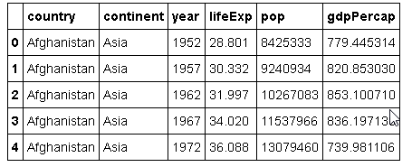
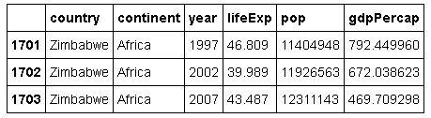
Show first/last n rows of dataset
Getting Started with Pandas
import pandas as pd
df = pd.read_csv('data/gapminder.tsv', sep='\t')
# Get the 5 rows of the dataset
df.head(5)
# Get the last 3 rows of the dataset
df.tail(3)
Official (Open) Non-Sensitive

Slide 11
Count how many cols and rows loaded
Getting Started with Pandas
import pandas as pd
df = pd.read_csv('data/gapminder.tsv', sep='\t')
print(df.shape)
Official (Open) Non-Sensitive

Slide 12
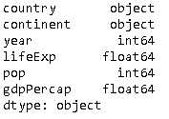
Print out the columns and their datatypes
Getting Started with Pandas
import pandas as pd
df = pd.read_csv('data/gapminder.tsv', sep='\t')
print(df.dtypes)
Official (Open) Non-Sensitive

Slide 13
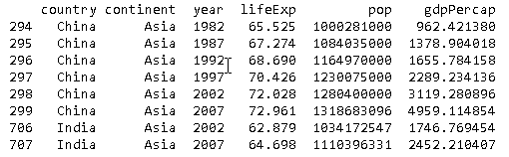
Extract subsets of the dataset
Getting Started with Pandas
import pandas as pd
df = pd.read_csv('data/gapminder.tsv', sep='\t')
# Extract only the country and continent columns
print(df[['country','continent']])
# Extract only rows with population more than 1000 million print(df[df['pop'] > 100000000])
Official (Open) Non-Sensitive

Slide 14
Save a subset of the data
Getting Started with Pandas
import pandas as pd
df = pd.read_csv('data/gapminder.tsv', sep='\t')
# Extract only the country and continent columns
df1 = df[['country','continent']]
# Extract only rows with population more than 1000 million df2 = df[df['pop'] > 100000000]
df1.to_csv('countrycontinents.csv')
df2.to_csv('populatedcountries.csv')
Official (Open) Non-Sensitive

Slide 15
Loading / Saving Data
Official (Open) Non-Sensitive

Slide 16
Loading Data
Loading and Saving Data
Pandas provides methods to load data from a variety of sources
Loading data from csv, Excel, HTML, json, SQL
csv_dataframe = pd.read_csv('my_dataset.csv', sep=',')
xls_dataframe = pd.read_excel('my_dataset.xlsx', 'Sheet1', na_values=['NA', '?'])
table_dataframe= pd.read_html('http://page.com/with/table.html')[0]
json_dataframe = pd.read_json('my_dataset.json', orient='columns')
from sqlalchemy import create_engine engine = create_engine('sqlite:///:memory:') sql_dataframe = pd.read_sql_table('my_table', engine, columns=['ColA', 'ColB']) sql_dataframe = pd.read_sql("SELECT * FROM my_table;", engine)
Official (Open) Non-Sensitive
Notes:
Except in certain cases, like a database table where the columns are clearly defined, the first row of your data is used as the column headers. Therefore if your data starts from the first line and you don't actually have a header row, ensure you pass in the names parameter (a list of column header names) when you call any .read_*() method. Pandas will use the provided headers in place of your first data entry.
If you do have column titles already defined in your dataset but wish to rename them, in that case, use the writeable .columns property:
my_dataframe.columns = ['new', 'column', 'header', 'labels']
https://pandas.pydata.org/pandas-docs/stable/generated/pandas.read_html.html
pandas.read_html(io, match='.+', flavor=None, header=None, index_col=None, skiprows=None, attrs=None, parse_dates=False, tupleize_cols=None, thousands=', ', encoding=None, decimal='.', converters=None, na_values=None, keep_default_na=True)
https://pandas.pydata.org/pandas-docs/stable/generated/pandas.read_json.html
pandas.read_json(path_or_buf=None, orient=None, typ='frame', dtype=True, convert_axes=True, convert_dates=True, keep_default_dates=True, numpy=False, precise_float=False, date_unit=None, encoding=None, lines=False, chunksize=None, compression='infer')[source]

Slide 17
Saving Data
Loading and Saving Data
Similarly, pandas provides methods to save data to a variety of sources
Saving data to csv, Excel, HTML, json, SQL
my_dataframe.to_csv('dataset.csv')
my_dataframe.to_excel('dataset.xlsx')
html_code = my_dataframe.to_html()
my_dataframe.to_json('dataset.json')
from sqlalchemy import create_engine engine = create_engine('sqlite:///:memory:') sql_dataframe.to_sql('my_table', engine)
Official (Open) Non-Sensitive
Notes:
https://pandas.pydata.org/pandas-docs/stable/generated/pandas.DataFrame.to_html.html
DataFrame.to_html(buf=None, columns=None, col_space=None, header=True, index=True, na_rep='NaN', formatters=None, float_format=None, sparsify=None, index_names=True, justify=None, bold_rows=True, classes=None, escape=True, max_rows=None, max_cols=None, show_dimensions=False, notebook=False, decimal='.', border=None)[source]
https://pandas.pydata.org/pandas-docs/stable/generated/pandas.DataFrame.to_json.html
DataFrame.to_json(path_or_buf=None, orient=None, date_format=None, double_precision=10, force_ascii=True, date_unit='ms', default_handler=None, lines=False, compression=None)[source]

Slide 18
Pandas Data Structures
Official (Open) Non-Sensitive

Slide 19
Overview
Pandas Data Structures
There are three main data structures in pandas
In this module, we will cover Series and DataFrame only
Series
DataFrame
Panel
Notes:
https://pandas.pydata.org/pandas-docs/stable/dsintro.html
https://pandas.pydata.org/pandas-docs/stable/generated/pandas.Panel.html

Slide 20
Series
Intro to Pandas
Series is a one-dimensional labelled array capable of holding any data type (integers, strings, floating point numbers, Python objects etc.)
The axis labels are collectively referred to as the index
The basic method to create a Series is as follows:-
import pandas as pd ser = pd.Series(data, index=idx)
data can be many different things: a Python dict, an ndarray, a scalar value (like 5)
index is a list of axis labels and are initialized differently depending on what the nature of data is (see next slides for examples)
Official (Open) Non-Sensitive

Slide 21

Creating Series (using Python dictionary)
Pandas Data Structures
If data is a dict, if index is passed the values in data corresponding to the labels in the index will be pulled out
Otherwise, an index will be constructed from the sorted keys of the dict, if possible.
import pandas as pd
currencyDict ={
'US':'dollar', 'UK':'pound',
'Mexico':'peso', 'China':'yuan'}
currencySeries = pd.Series(currencyDict);
index
Official (Open) Non-Sensitive

Slide 22

Creating Series (Using numpy.ndarray)
Pandas Data Structures
If data is an ndarray, index must be the same length as data
If no index is passed, one will be created having values [0, ..., len(data) - 1].
import pandas as pd
import numpy as np
s = pd.Series(np.random.randn(5),
index=['a', 'b', 'c', 'd', 'e'])
Official (Open) Non-Sensitive

Slide 23
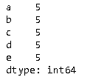
Creating Series (using scalar values)
Pandas Data Structures
If data is a scalar value, an index must be provided
The value will be repeated to match the length of index
import pandas as pd
pd.Series(5, index=['a', 'b', 'c', 'd', 'e'])
Official (Open) Non-Sensitive

Slide 24
DataFrame
Pandas Data Structures
DataFrame is the most commonly used data structure in pandas
DataFrame is a 2-dimensional labeled data structure
You can think of it like a spreadsheetor SQL table, or a dict of Series object
The constructor accepts many different types of arguments
2D NumPy array
Dictionary of 1D NumPy array or lists, dictionaries, or Series structures
Structured or record ndarray
Series structures
Another DataFrame structure
Official (Open) Non-Sensitive
Notes:
http://pandas.pydata.org/pandas-docs/stable/dsintro.html#dataframe

Slide 25
DataFrame
Pandas Data Structures
The basic method to create a DataFrame is as follows:-
import pandas as pd df = pd.DataFrame(data,index,columns)
data : numpy ndarray, dict, Series or DataFrame
index : Index to use for resulting frame. Default to np.arange(n)
columns : Column labels to use for resulting frame. Default to np.arange(n)
Official (Open) Non-Sensitive

Slide 26
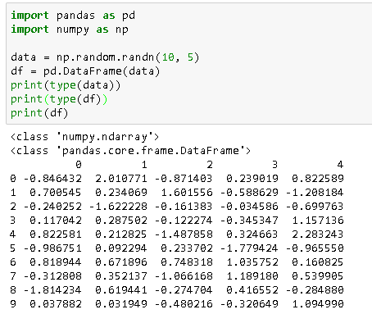
Create DataFrame (Using 2d Numpy Array)
Pandas Data Structures
import pandas as pd
import numpy as np
# data is a numpy 10x5 ndarray
# of random numbers
data = np.random.randn(10, 5)
df = pd.DataFrame(data)
print(type(data))
print(type(df))
print(df)
Official (Open) Non-Sensitive

Slide 27
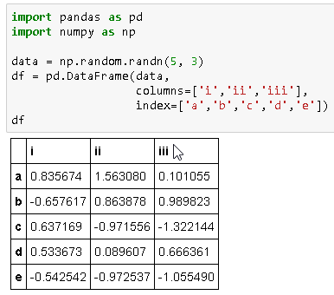
Create DataFrame (Using 2d Numpy Array)
Pandas Data Structures
import pandas as pd
import numpy as np
data = np.random.randn(5, 3)
df = pd.DataFrame(data, columns=['i','ii','iii'],
index=['a','b','c','d','e'] )
You can specify the column names and index references when creating the DataFrame object
Official (Open) Non-Sensitive

Slide 28
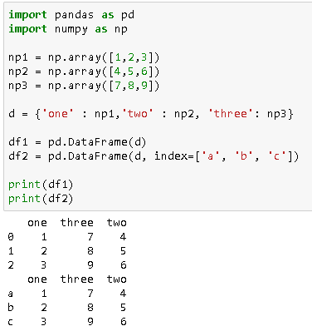
Create DataFrame (dict of 1d Numpy array)
Pandas Data Structures
import pandas as pd
import numpy as np
np1 = np.array([1,2,3])
np2 = np.array([4,5,6])
np3 = np.array([7,8,9])
d = {'one' : np1, 'two' : np2,
'three': np3}
df1 = pd.DataFrame(d)
df2 = pd.DataFrame(d, index=['a', 'b', 'c'])
In this case, the column names are derived automatically from the dict keys
Official (Open) Non-Sensitive

Slide 29
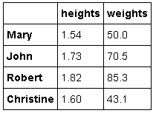
Create DataFrame (dict of lists)
Pandas Data Structures
import pandas as pd
d = {'weights' :[50,70.5,85.3,43.1],
'heights' : [1.54,1.73,1.82,1.6]}
df1 = pd.DataFrame(d)
df2 = pd.DataFrame(d, index=['Mary', 'John', 'Robert', 'Christine'])
In this case, the column names are derived automatically from the dict keys
Official (Open) Non-Sensitive

Slide 30
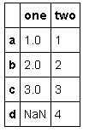
Create DataFrame (dict of Series)
Pandas Data Structures
import pandas as pd
d = {
'one' : pd.Series([1, 2, 3],
index=['a', 'b', 'c']),
'two' : pd.Series([1, 2, 3, 4], index=['a', 'b', 'c', 'd'])
}
df = pd.DataFrame(d)
In this case, the column names are derived automatically from the dict keys
Official (Open) Non-Sensitive

Slide 31
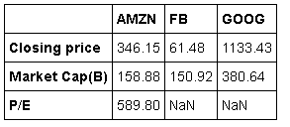
Create DataFrame (dict of Series)
Pandas Data Structures
import pandas as pd
stockSummaries={
'AMZN':pd.Series([346.15, 589.8,158.88], index=['Closing price','P/E','Market Cap(B)']),
'GOOG':pd.Series([1133.43, 380.64], index=['Closing price','Market Cap(B)']),
'FB':pd.Series([61.48, 150.92], index=['Closing price','Market Cap(B)'])}
stockDF = pd.DataFrame(stockSummaries)
In this case, the column names are derived automatically from the dict keys
Official (Open) Non-Sensitive

Slide 32

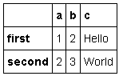
Create DataFrame (structured record/array)
Pandas Data Structures
df
import pandas as pd
data = [(1,2,'Hello'), (2,3,"World")]
df = pd.DataFrame(data)
df2 = pd.DataFrame(data,
index=['first', 'second'],
columns=['a','b','c'])
df2
Official (Open) Non-Sensitive

Slide 33
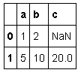
Create DataFrame (list of dicts)
Pandas Data Structures
df
import pandas as pd
data = [{'a': 1, 'b': 2},
{'a': 5, 'b': 10, 'c': 20}
]
df = pd.DataFrame(data)
In this case, the column names are derived automatically from the dict keys
Official (Open) Non-Sensitive

Slide 34
Retrieving Information
Official (Open) Non-Sensitive

Slide 35
Basic Information
Retrieving Information
Method | Description
df.shape | Returns (rows, columns)
df.index | Describe index
df.columns | Describe DataFrame column s
df.count() | Number of non NA values
df.info() | Info on DataFrame
df.dtypes | Data types
Official (Open) Non-Sensitive

Slide 36
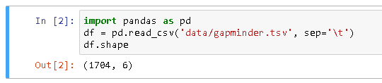
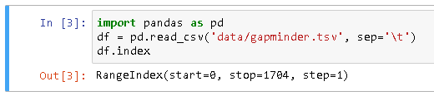
Basic Information
Retrieving Information
df.shape
df.index
Official (Open) Non-Sensitive

Slide 37

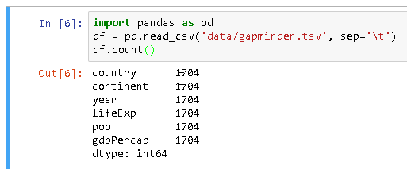
Basic Information
Retrieving Information
df.columns
df.count
Official (Open) Non-Sensitive

Slide 38
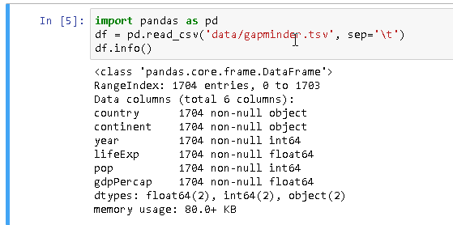
Basic Information
Retrieving Information
df.info
Official (Open) Non-Sensitive

Slide 39
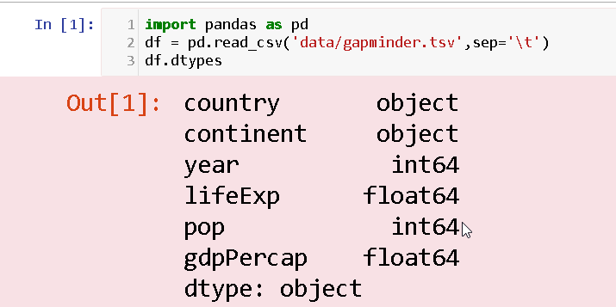
Basic Information
Retrieving Information
df.dtypes
Official (Open) Non-Sensitive

Slide 40
Summary
Retrieving Series and DataFrame Information
Method | Description
df.sum() | Sum of values
df.cumsum() | Cumulative sum of values
df.min(), df.max() | Minimum / Maximum values
df.idxmin(), df.idxmax() | Minimum / Maximum Index Value
df.describe | Summary Statistics
df.mean() | Mean of values
df.median() | Median of values

Slide 41
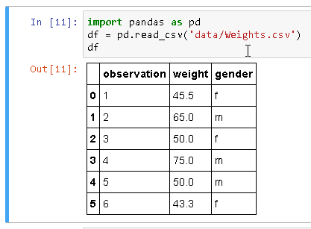
Summary
Retrieving Information
Original dataset - df
Official (Open) Non-Sensitive

Slide 42
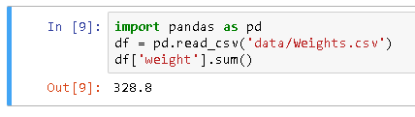
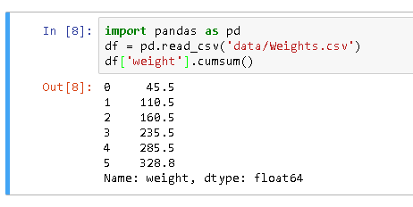
Summary
Retrieving Information
df.sum
df.cumsum
Official (Open) Non-Sensitive

Slide 43
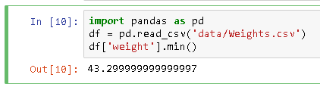
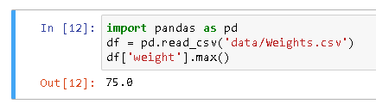
Summary
Retrieving Information
df.min()
df.max()
Official (Open) Non-Sensitive

Slide 44
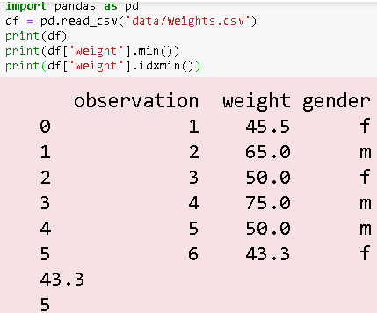
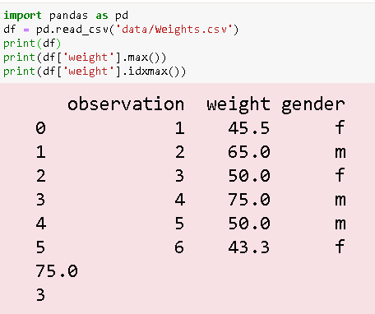
Summary
Retrieving Information
df.idxmin()
df.idxmax()
Official (Open) Non-Sensitive

Slide 45
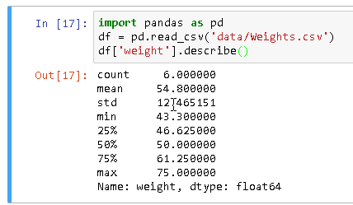
Summary
Retrieving Information
df.describe()
Official (Open) Non-Sensitive

Slide 46
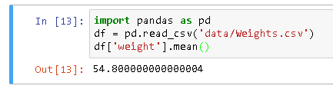
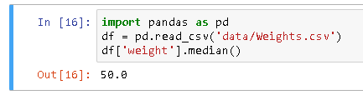
Summary
Retrieving Information
df.mean()
df.median()
Official (Open) Non-Sensitive

Slide 47
Subsetting columns
Subsetting Columns
Method | Description
df['width'] or df.width | Subset a single column by column name
df[['width','length','species']] | Subset multiple columns by column names
df.loc[:, 'A':'C'] | Subset a range of columns by column names using loc
df.iloc[:,2] | Subset a single column by its index using iloc
df.iloc[:, [0, -1]] | Subset multiple columns by their indices using iloc
df.iloc[:, 0:2] | Subset a range of columns by index using iloc
df.loc[:,'pop'] > 100000 | Create derived columns by using Boolean logic
re = '^customer' df.filter(regex=re) | Subset columns whose names match a regular expression, e.g. where data contains 'customer'
Official (Open) Non-Sensitive

Slide 48
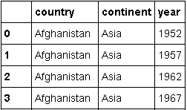
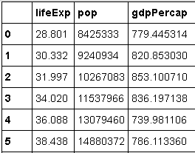
Subsetting columns (by column name)
Subsetting Columns
import pandas as pd
df = pd.read_csv('gapminder.tsv', sep='\t')
Subset a single column by column name
df1 = df['country']
df2 = df.country
# Subset multiple columns by column names
df3 = df[['country', 'continent', 'year']]
# Subset a range of columns using loc
df4 = df.loc[:, 'lifeExp':'gdpPercap']
df3
df4
Subsetting columns by name
Official (Open) Non-Sensitive

Slide 49
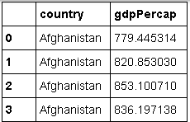
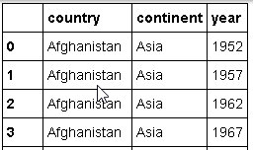
Subsetting columns (by index)
Subsetting Columns
import pandas as pd
df = pd.read_csv('gapminder.tsv', sep='\t')
# Subset a single column by its index
df0 = df.iloc[:,0]
# Subset multiple columns by their indices
df2 = df.iloc[:,[0,-1]]
# Subset a range of columns using iloc
df3 = df.iloc[:, 0:3]
df2
df3
Subsetting columns by index
Official (Open) Non-Sensitive
Notes:
https://pandas.pydata.org/pandas-docs/stable/generated/pandas.DataFrame.iloc.html

Slide 50
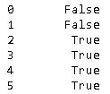
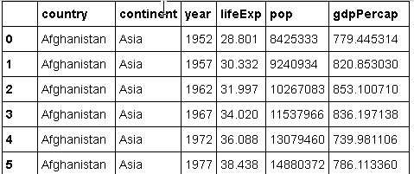
Subsetting columns (by boolean logic)
Subsetting Columns
import pandas as pd
df = pd.read_csv('gapminder.tsv', sep='\t')
# create a Boolean column
df1 = df.loc[:,'pop'] > 10000000
# print the rows that are True
print(df[df1]
Subsetting columns by Boolean logic
Official (Open) Non-Sensitive

Slide 51
Subsetting columns (by reg expression)
Subsetting Columns
import pandas as pd
df = pd.read_csv('gapminder.tsv', sep='\t')
re1 = '\.' # Match strings containing a period
re2 = 'p$' # Match strings ending with p
re3 = '^c' # Match strings starting with c
re4 = '^c[1-5]$' #Match strings starting with c and ending with 1,2,3,4,5
re5 = '^(?!pop$).*' # Match strings except those containing pop
df = df.filter(regex=re2)
Subsetting columns by regular expressions
Official (Open) Non-Sensitive

Slide 52
Subsetting rows
Subsetting Rows
Method | Description
df.loc['a':'c'] | Select rows by label
df.iloc[10:20,:] | Select rows by index
df[df.Length > 7] | Select rows by Boolean logic
df.head(n) | Select first n rows
df.tail(n) | Select last n rows
df.sample(frac=0.5) | Randomly select fraction of rows.
df.sample(n=10) | Randomly select n rows
df.nlargest(n, 'value') | Select and order top n entries
df.nsmallest(n, 'value') | Select and order bottom n entries
df.drop_duplicates() | Select unique rows only (duplicates removed)
Official (Open) Non-Sensitive

Slide 53
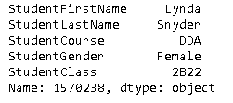
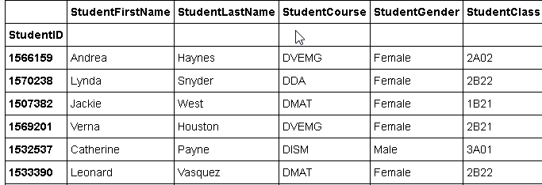
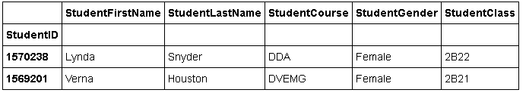
Subsetting rows (by label)
Subsetting Rows
Subsetting rows by label
import pandas as pd df = pd.read_csv('studentsdataset.csv', index_col='StudentID')
df1 = df.loc[1516045]
df2 = df.loc[[1516045,1532537]]
df1
df2
df
53
Official (Open) Non-Sensitive

Slide 54
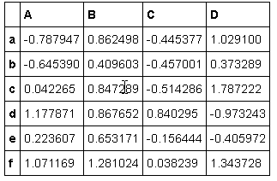
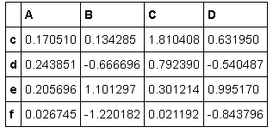
Subsetting rows (by label)
Subsetting Rows
import pandas as pd
import numpy as np df = pd.DataFrame(np.random.randn(6, 4),
index=list('abcdef'),
columns=list('ABCD'))
df1 = df.loc['c':'f']
df
df1
Subsetting rows by label
54
Official (Open) Non-Sensitive

Slide 55
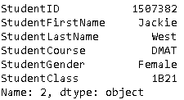
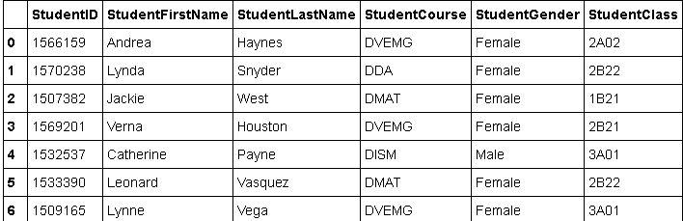
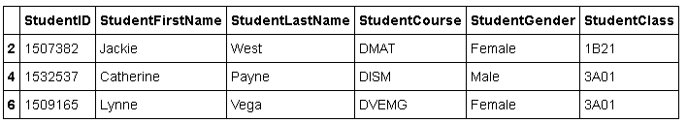
Subsetting rows (by index)
Subsetting Rows
Subsetting rows by index
import pandas as pd df = pd.read_csv('studentsdataset.csv')
df1 = df.iloc[2] df2 = df.iloc[[2,4,6]]
df1
df2
df
55
Official (Open) Non-Sensitive

Slide 56
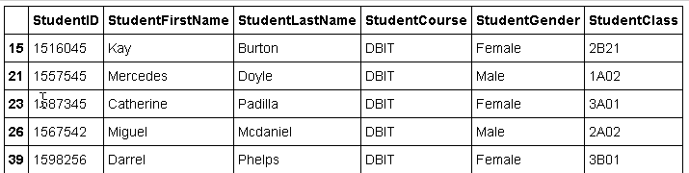
Subsetting rows (by boolean logic)
Subsetting Rows
Subsetting rows by Boolean logic
import pandas as pd df = pd.read_csv('studentsdataset.csv')
# Select only rows with col course = DBIT
df1 = df[df.StudentCourse == 'DBIT']
df2 = df[df.StudentCourse.isin( ['DBIT','DIT'])]
df1
df
Official (Open) Non-Sensitive

Slide 57
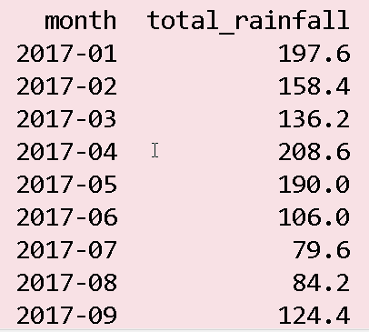
Subsetting rows (by regex matching)
Subsetting Rows
Subsetting rows by regular expression matching
import pandas as pd df = pd.read_csv('rainfall.csv')
# Regular expression - starts with 2017
re2017 = '^2017'
# Extract dataset with months from 2017
df2017 = df[df['month'].str.contains(re2017)]
Official (Open) Non-Sensitive

Slide 58
Reshaping Data
Change the layout of a data set
Official (Open) Non-Sensitive

Slide 59
Change the layout of datasets
Reshaping Data
Method | Description
df.drop(['Length','Height'], axis=1) | Drop columns from a DataFrame
pd.concat | Append rows to DataFrames
pd.concat | Append columns to DataFrames
df.pivot | Spread rows into columns
pd.melt | Gather columns into rows
df.sort_values('mpg') | Sort DataFrame by column values
df.sort_index() | Sort DataFrame by index values
df.reindex() | Conform DataFrame to a new index
df.reset_index() | Reset the index of a DataFrame
df.rename(columns = {'y':'year'}) | Rename the columns of a DataFrame
Official (Open) Non-Sensitive

Slide 60
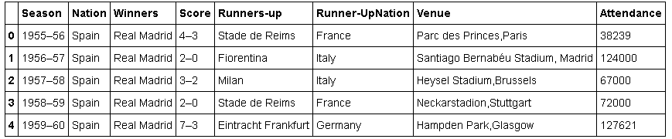
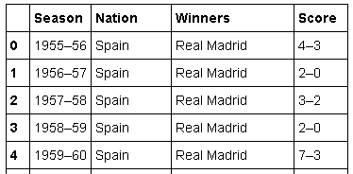
Drop columns from a DataFrame (drop)
Reshaping Data
df
import pandas as pd
df = pd.read_csv("data/euro_winners.csv")
df2= df.drop(['Runners-up', 'Runner-UpNation', 'Venue', 'Attendance'], axis=1)
df2
Official (Open) Non-Sensitive

Slide 61
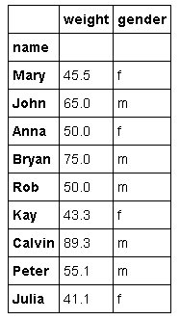
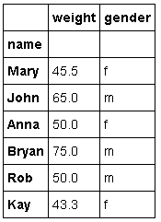
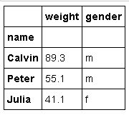
Append rows to DataFrames (concat)
Reshaping Data
import pandas as pd
df1 = pd.read_csv("data/Weights1.csv", index_col=['name'])
df2 = pd.read_csv("data/Weights2.csv", index_col=['name'])
result = pd.concat([df1,df2])
result
df1
df2
Official (Open) Non-Sensitive
Notes:
https://pandas.pydata.org/pandas-docs/stable/generated/pandas.concat.html
https://pandas.pydata.org/pandas-docs/stable/merging.html

Slide 62


Append columns to DataFrames (concat)
Reshaping Data
import pandas as pd
df1 = pd.read_csv("data/Weights1.csv",index_col=['name'])
df2 = pd.read_csv("data/Heights2.csv",index_col=['name'])
result = pd.concat([df1,df2])
result
df2
df1
Official (Open) Non-Sensitive
Notes:
https://pandas.pydata.org/pandas-docs/stable/generated/pandas.concat.html
https://pandas.pydata.org/pandas-docs/stable/merging.html

Slide 63


Spread rows into columns (pivot)
Reshaping Data
import pandas as pd
df = pd.read_csv("data/Weights.csv")
df2= df.pivot(index='observation',columns='gender',values='weight')
Before pivot
After pivot
Official (Open) Non-Sensitive
Notes:
https://pandas.pydata.org/pandas-docs/stable/generated/pandas.melt.html

Slide 64

Gather columns into rows (melt)
Reshaping Data
import pandas as pd
df = pd.read_csv("data/Weights.csv")
df2 = df.pivot(index='observation',columns='gender',values='weight')
df3 = pd.melt(df, id_vars=['observation','gender'])
After pivot, Before melt
Before pivot
After melt
Official (Open) Non-Sensitive
Notes:
https://pandas.pydata.org/pandas-docs/stable/generated/pandas.melt.html

Slide 65


Gather columns into rows (melt)
Reshaping Data
import pandas as pd
df = pd.read_csv("data/WeightsYears.csv")
#print(df)
df3 = pd.melt(df, id_vars=['Name'],value_vars=['2015','2016','2017'],
var_name="Year",
value_name="Weight")
print(df3)
Before melt
After melt
Official (Open) Non-Sensitive
Notes:
https://pandas.pydata.org/pandas-docs/stable/generated/pandas.melt.html

Slide 66

Sort DataFrame by column values
Reshaping Data
DataFrame.sort_values(by, axis=0, ascending=True, inplace=False, kind='quicksort', na_position='last')[source]
import pandas as pd
df = pd.read_csv("data/Weights.csv")
df2 = df.sort_values(by="weight")
Before sort
After sort
Official (Open) Non-Sensitive
Notes:
https://pandas.pydata.org/pandas-docs/stable/generated/pandas.DataFrame.sort_values.html

Slide 67


Sort DataFrame by index values
Reshaping Data
import pandas as pd
import numpy as np
dates = pd.date_range('20130101', periods=6)
df = pd.DataFrame(np.random.randn(6,4), index=dates, columns=list('ABCD'))
df2= df.sort_index(ascending=False)
df
df2
Official (Open) Non-Sensitive
Notes:
https://pandas.pydata.org/pandas-docs/stable/generated/pandas.DataFrame.sort_index.html

Slide 68



Sort DataFrame by index values (2)
Reshaping Data
import pandas as pd
df=pd.read_csv('data/stock_index_prices.csv')
df2=df.set_index(['TradingDate','PriceType'])
df3=df2.sort_index(ascending=False,level="PriceType")
df2
df
df3
Official (Open) Non-Sensitive
Notes:
https://pandas.pydata.org/pandas-docs/stable/generated/pandas.DataFrame.reindex.html

Slide 69


Reindex a DataFrame
Reshaping Data
import pandas as pd
index = ['Firefox', 'Chrome', 'Safari', 'IE10','Konqueror']
df = pd.DataFrame({
'http_status': [200,200,404,404,301],
'response_time': [0.04, 0.02, 0.07, 0.08, 1.0]},index=index) new_index= ['Safari', 'Iceweasel', 'Comodo Dragon', 'IE10','Chrome']
df.reindex(new_index)
Before reindexing
After reindexing
Official (Open) Non-Sensitive
Notes:
https://pandas.pydata.org/pandas-docs/stable/generated/pandas.DataFrame.reindex.html

Slide 70

Reset the index of a DataFrame
Reshaping Data
import pandas as pd
df=pd.read_csv('data/stock_index_prices.csv')
df = df.set_index(['TradingDate','PriceType'])
df= df.reset_index()
Before reset index
After reset index
Official (Open) Non-Sensitive
Notes:
https://pandas.pydata.org/pandas-docs/stable/generated/pandas.DataFrame.reset_index.html

Slide 71


Rename the columns of a DataFrame
Reshaping Data
import pandas as pd
import pandas as pd
df = pd.read_csv("data/Weights.csv")
df=df.rename(columns={"observation":"reading"})
Before rename
After rename
Official (Open) Non-Sensitive
Notes:
https://pandas.pydata.org/pandas-docs/stable/generated/pandas.DataFrame.rename.html

Slide 72
Handling Missing Data
Official (Open) Non-Sensitive

Slide 73
Handling Missing Data
Handling Missinng Data
Code Example | Description
isnull | Detect missing values (NaN in numeric arrays, None/NaN in object arrays)
notnull | Replacement for numpy.isfinite / -numpy.isnan which is suitable for use on object arrays
df.dropna | Drop rows with any column having NA/null data
df.fillna | Replace all NA/null data with value
Official (Open) Non-Sensitive
Notes:
https://pandas.pydata.org/pandas-docs/stable/generated/pandas.isnull.html
https://pandas.pydata.org/pandas-docs/stable/generated/pandas.notnull.html

Slide 74
When / why does data become missing?
Handling Missing Data
Many data sets simply arrive with missing data, either because it exists and was not collected or it never existed
For example, in a collection of financial time series, some of the time series might start on different dates. Thus, values prior to the start date would generally be marked as missing
Official (Open) Non-Sensitive

Slide 75


E.g how reindexing causes missing data
Handling Missing Data
df1 = pd.DataFrame(np.random.randn(3, 3), index=['a', 'b', 'c', columns=['one', 'two', 'three'])
df2 = df1.reindex(['a', 'b', 'c', 'd'])
Official (Open) Non-Sensitive

Slide 76
Values considered missing
Handling Missing Data
As data comes in many shapes and forms, pandas aims to be flexible with regards to handling missing data
While NaN is the default missing value marker for reasons of computational speed and convenience, we need to be able to easily detect this value with data of different types: floating point, integer, boolean, and general object
In many cases, however, the Python None will arise and we wish to also consider that “missing” or “null”.
Official (Open) Non-Sensitive

Slide 77
isnull() / notnull()
Handling Missing Data
To make detecting missing values easier (and across different array dtypes), pandas provides the isnull() and notnull() functions, which are also methods on Series and DataFrame objects
import pandas as pd
df = pd.read_csv('ratings.csv')
print(pd.isnull(df['rating']))
77
Official (Open) Non-Sensitive

Slide 78

dropna
Handling Missing Data
import pandas as pd
df = pd.read_csv('data/kidney_disease.csv')
df2 = df.dropna()
Original dataset with NaN values. See the next slide for comparison after using dropna
78
Official (Open) Non-Sensitive

Slide 79

dropna
Handling Missing Data
79
Official (Open) Non-Sensitive

Slide 80
fillna (scalar values)
Handling Missing Data
The fillna function can “fill in” NA values with non-null data in a few ways:
scalar values
fill gaps forwards
fill gaps backwards
80
Official (Open) Non-Sensitive

Slide 81
fillna (scalar values)
Handling Missing Data
import pandas as pd
df = pd.read_csv('data/kidney_disease.csv')
# Replace NA with a scalar value
df2 = df.fillna(0)
Original dataset with NaN values. See the next slide for comparison after using fillna
81
Official (Open) Non-Sensitive
Notes:
http://pandas.pydata.org/pandas-docs/stable/missing_data.html#filling-missing-values-fillna

Slide 82

fillna (scalar values)
Handling Missing Data
82
Official (Open) Non-Sensitive

Slide 83
fillna (fill gaps forward)
Handling Missing Data
import pandas as pd
df = pd.read_csv('data/kidney_disease.csv')
# Fill gaps forwards
df2 = df.fillna(method='pad')
Original dataset with NaN values. See the next slide for comparison after using fillna
83
Official (Open) Non-Sensitive

Slide 84

fillna (fill gaps forward)
Handling Missing Data
84
Official (Open) Non-Sensitive

Slide 85
fillna (fill gaps backward)
Handling Missing Data
import pandas as pd
df = pd.read_csv('data/kidney_disease.csv')
# Fill gaps forwards
df2 = df.fillna(method='bfill')
Original dataset with NaN values. See the next slide for comparison after using fillna
85
Official (Open) Non-Sensitive

Slide 86

fillna (fill gaps backward)
Handling Missing Data
86
Official (Open) Non-Sensitive

Slide 87
fillna (mean)
Handling Missing Data
import pandas as pd
df = pd.read_csv('data/kidney_disease.csv')
df.rc = pd.to_numeric(df.rc, errors='coerce')
# Replace NA with the mean of the values of the column
df2 =df.fillna(df.mean())
Original dataset with NaN values. See the next slide for comparison after using fillna
87
Official (Open) Non-Sensitive
Notes:
http://pandas.pydata.org/pandas-docs/stable/missing_data.html#filling-missing-values-fillna

Slide 88

fillna (mean)
Handling Missing Data
88
Official (Open) Non-Sensitive

Slide 89
Combine Data Sets
Official (Open) Non-Sensitive

Slide 90
Combine Data Sets
Combine Data Sets
Code Example | Description
pd.merge(adf, bdf, how='left', on='x1') | Get all rows from adf and only those rows from bdf that have a match with adf on the column x1
pd.merge(adf, bdf, how='right', on='x1') | Get all rows from bdf and only those rows from adf that have a match with bdf on the column x1
pd.merge(adf, bdf, how='inner', on='x1') | Join matching rows from both adf and bdf
pd.merge(adf, bdf, how='outer', on='x1') | Join all rows from adf and bdf
adf[adf.x1.isin(bdf.x1)] | All rows in adf that have a match in bdf.
adf[~adf.x1.isin(bdf.x1)] | All rows in adf that do not have a match in bdf
Official (Open) Non-Sensitive
Notes:
https://pandas.pydata.org/pandas-docs/stable/generated/pandas.DataFrame.isin.html

Slide 91


merge (how='left')
Combine Data Sets
import pandas as pd
df1 = pd.read_csv('data/mergedataset1s.csv')
df2 = pd.read_csv('data/mergedataset2s.csv')
df = pd.merge(df1, df2, how='left', on='customerid')
df1- mergedataset1s.csv
df2 - mergedataset2s.csv
Original datasets before merging. See the next slide for comparison after merging.
91
Official (Open) Non-Sensitive

Slide 92

merge (how='left')
Combine Datasets
92
Official (Open) Non-Sensitive

Slide 93
merge (how='right')
Combine Data Sets
import pandas as pd
df1 = pd.read_csv('data/mergedataset1s.csv')
df2 = pd.read_csv('data/mergedataset2s.csv')
df = pd.merge(df1, df2, how='right', on='customerid')
df1- mergedataset1s.csv
df2 - mergedataset2s.csv
Original datasets before merging. See the next slide for comparison after merging.
93
Official (Open) Non-Sensitive

Slide 94

merge (how='right')
Combine Datasets
94
Official (Open) Non-Sensitive

Slide 95
merge (how='inner')
Combine Data Sets
import pandas as pd
df1 = pd.read_csv('data/mergedataset1s.csv')
df2 = pd.read_csv('data/mergedataset2s.csv')
df = pd.merge(df1, df2, how='inner', on='customerid')
df1- mergedataset1s.csv
df2 - mergedataset2s.csv
Original datasets before merging. See the next slide for comparison after merging.
95
Official (Open) Non-Sensitive

Slide 96

merge (how='inner')
Combine Datasets
96
Official (Open) Non-Sensitive

Slide 97
isin
Combine Data Sets
import pandas as pd
df1 = pd.read_csv('data/mergedataset1s.csv')
df2 = pd.read_csv('data/mergedataset2s.csv')
df = df1[df1.customerid.isin(df2.customerid)]
df1- mergedataset1s.csv
df2 - mergedataset2s.csv
Original datasets before merging. See the next slide for comparison after merging.
97
Official (Open) Non-Sensitive

Slide 98

isin
Combine Datasets
98
Official (Open) Non-Sensitive

Slide 99
~isin
Combine Data Sets
import pandas as pd
df1 = pd.read_csv('data/mergedataset1s.csv')
df2 = pd.read_csv('data/mergedataset2s.csv')
df = df1[~df1.customerid.isin(df2.customerid)]
df1- mergedataset1s.csv
df2 - mergedataset2s.csv
Original datasets before merging. See the next slide for comparison after merging.
99
Official (Open) Non-Sensitive

Slide 100

~isin
Combine Datasets
100
Official (Open) Non-Sensitive

Slide 101
Group Data
Official (Open) Non-Sensitive

Slide 102
Group data
Group Data
Code Example | Description
df1 = df.groupby(by='col) | Return a GroupBy object, grouped by values in column named 'col'
df1 = df.groupby(level='ind') | Return a GroupBy object, grouped by values in index level named 'ind'
df1.groups | The dictionary of groups
len(df1.groups) | Number of groups in the dictionary
size() | Size of each group
agg(function) | Aggregate group using function
Official (Open) Non-Sensitive

Slide 103

Study the partial dataset below which stores the results of the European club soccer championship since 1955
Official (Open) Non-Sensitive

Slide 104

Suppose we wanted to rank the nations by the number of European club championships they have won
We can achieve this by using the groupby function
Official (Open) Non-Sensitive

Slide 105

Grouping Data
Group Data
import pandas as pd
df = pd.read_csv("data/euro_winners.csv")
# Returns a dictionary of DataFrameGroupBy objects
nationsGrp = df.groupby(['Nation'])
nationWins = nationsGrp.size()
nationWins.sort_values(ascending=False)
105
Official (Open) Non-Sensitive

Slide 106

Let's say we want to further find out the total wins, not only by country alone, but by club as well.
We can achieve this by using multicolumn groupby function in Pandas
Official (Open) Non-Sensitive

Slide 107

Grouping Data
Group Data
import pandas as pd
df = pd.read_csv("data/euro_winners.csv")
# To do a further breakup by country and club # apply a multicolumn groupby function
winnersGrp = df.groupby(['Nation','Winners'])
clubWins=winnersGrp.size() clubWins.sort_values(ascending=False)
107
Official (Open) Non-Sensitive

Slide 108

apply (for panda Series)
Applying functions to Pandas Series and DataFrames
import pandas as pd
import numpy as np
series = pd.Series([20, 21, 12], index=['London','New York','Helsinki'])
def toFahrenheit(x):
return x*32
series = series.apply(toFahrenheit)
Datasets before and after applying the function
108
Official (Open) Non-Sensitive
Notes:
https://pandas.pydata.org/pandas-docs/stable/generated/pandas.Series.apply.html

Slide 109


apply (for panda DataFrame)
Applying functions to Pandas Series and DataFrames
Applies function along input axis of DataFrame
import pandas as pd
import numpy as np
data = np.random.randint(1,10,(3,2))
df = pd.DataFrame(data, index=['Student 1', 'Student 2', 'Student 3'],columns=['Reward 1', 'Reward 2'])
def multiply(x):
return x*2
df = df.apply(multiply)
Dataset before applying the function
Dataset after applying the function
109
Official (Open) Non-Sensitive
Notes:
https://pandas.pydata.org/pandas-docs/stable/generated/pandas.DataFrame.apply.html

Slide 110


apply (for panda DataFrame)
Applying functions to Pandas Series and DataFrames
Applies function along input axis of DataFrame
data = {'name': ['Jason', 'Molly', 'Tina', 'Jake', 'Amy'],
'year': [1989, 1990, 1994, 1979, 1975]}
df = pd.DataFrame(data)
# Create a capitalization lambda function
capitalizer = lambda x: x.upper()
# Apply the capitalizer function over the column 'name'
df['name'].apply(capitalizer)
Dataset before applying the function
Dataset after applying the function
110
Official (Open) Non-Sensitive
Notes:
https://pandas.pydata.org/pandas-docs/stable/generated/pandas.DataFrame.apply.html

Slide 111
End of Topic 3
Official (Open) Non-Sensitive

